Slide 1
Frequency-Dependent Changes in Sensorimotor and pain affective systems induced by empathy for pain
-M. Yoshimasa et al.

Slide 2

Humans are social animals
Image credits: https://exploringyourmind.com/why-do-children-imitate-adults/

Slide 3
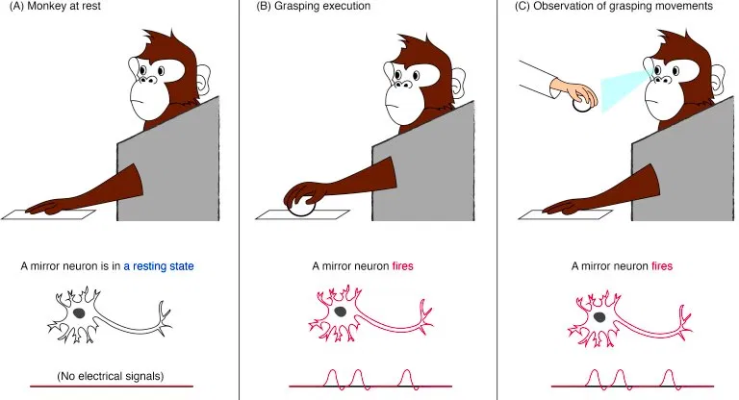
Mirror Neurons
Image credits: http://sitn.hms.harvard.edu/flash/2016/mirror-neurons-quarter-century-new-light-new-cracks/

Slide 4
Empathy for pain induces not only Affective – motivational representations, but also sensory – discriminatory representations in the Brain. Thus, we can use empathic pain to explore the pain system without inducing actual pain.(M. Yoshimasa et al.)

Slide 6
Results

Slide 7
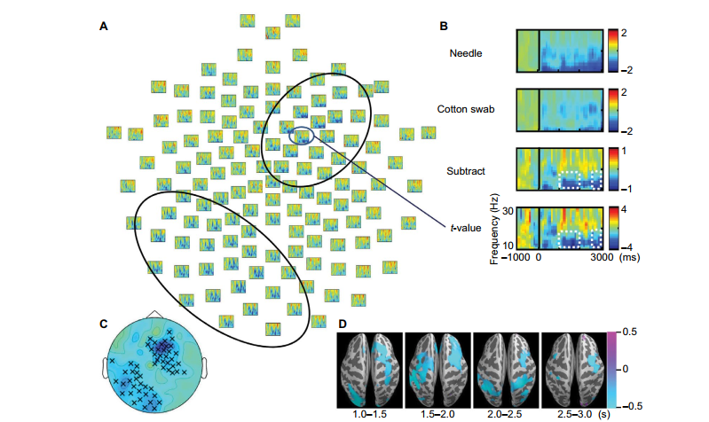
Oscillations in the alpha / beta band (10-30Hz)

Slide 8
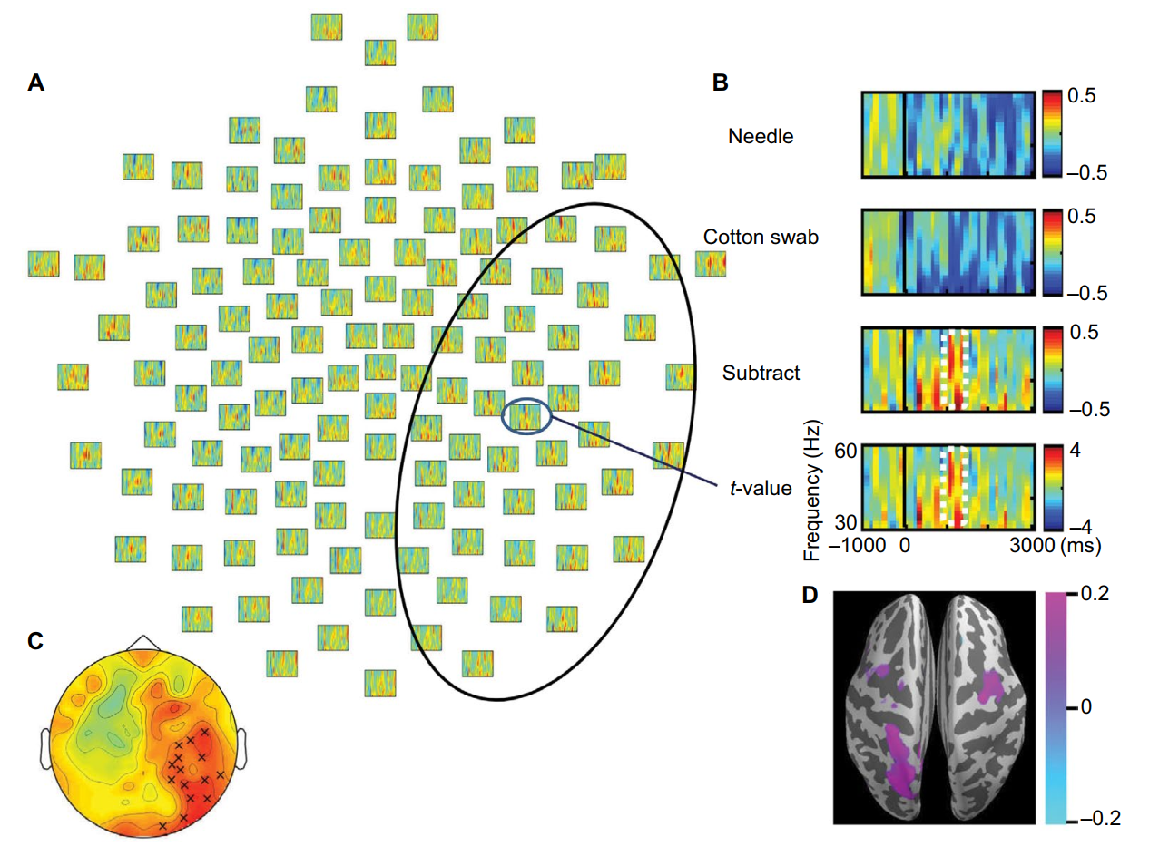
Oscillations in the gamma band (10-30Hz)

Slide 9
